Slide 1
Text and Sentiment Analysis
Cisco IT

Slide 2
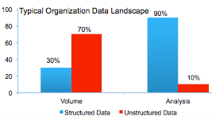
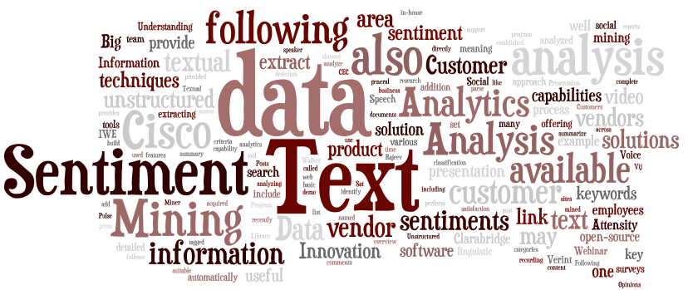


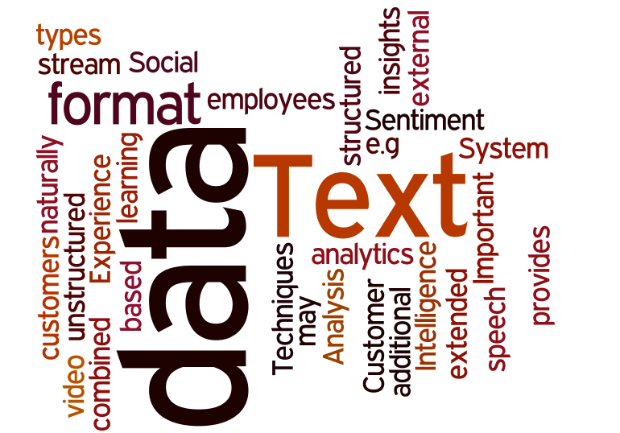
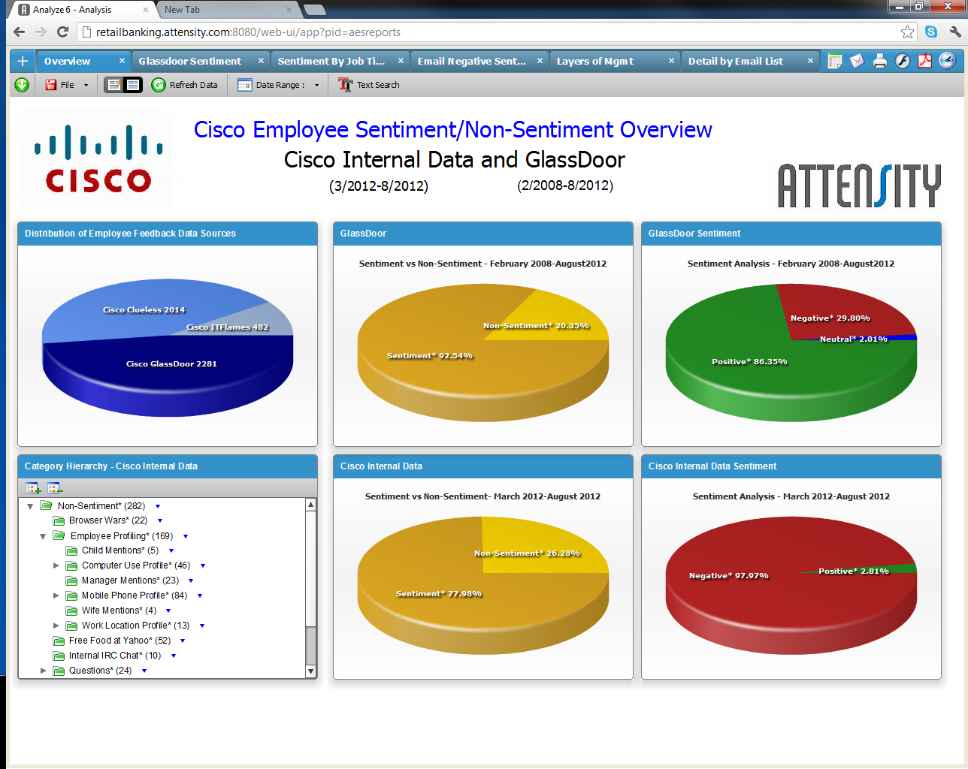


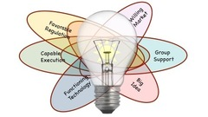
Text and Sentiment Analysis
Data Analysis Gaps
Unstructured Data
Company Growth
Natural Language Processing
The POWER TO UNDERSTAND YOUR Customers and Employees
Listen, Relate and Act
POC on Social and Email forums
Surveys/Feedback
Web / Social Media
Who?
Customers Partners Employee Industry
What?
Products Services Events Work
Listening?
Opinions Feedback Complaints Ideas
Benefits
Correlate Improve Focus Productive
Discover, Predict with Actionable Insights

Slide 3

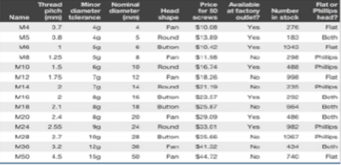
Unstructured Data Analysis Gaps
Typical Organization Data Landscape
90 %
70 %
Unstructured data not analyzed or analyzed in silos
30 %
10 %
Databases, Tables, Excel
Feedback, comments, news, social, chats
Notes:
Mention state of Text analytics in cisco as was in 2007 for data warehouse

Slide 4
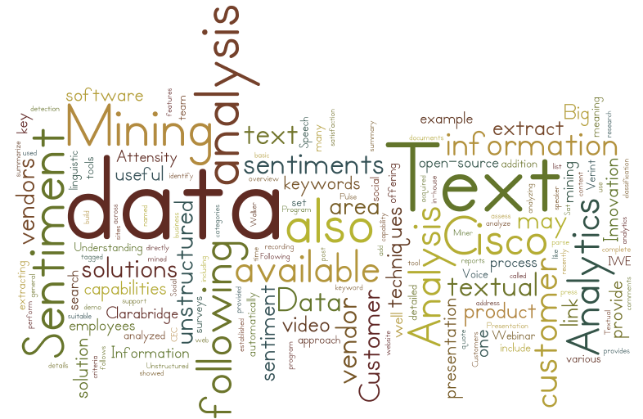
Common Usage
Text and Sentiment Analysis
Text Processing
Listening /Sentiment Analysis
Semantic Web 3.0 / Knowledge Mgmt.
Search
Topics detection
Analyzing Document collection
Entity Extraction
Summarization
Search queries
Finding relevant documents
Voice of Customers
Voice of Employees
Influencers Analysis
Linking Key Entities to Transactions
Notes:
Market Research: Understanding your competitive place in the market can inform new product launches tune the messaging.
Service Improvements, Better Advertising
Extract important data from documents or identify major themes
Summarization
Entity Extraction

Slide 5
Text and Sentiment Analytics ROI
ROI
Increase Revenue
Reduce Cost / Improve Productivity

Slide 6
Current Usage at Cisco
Department / Contacts | Solution Summary | Vendor
Integrated Marketing and Communication Charlie Treadwell (gtreadwe) Elizabeth Rector (erector) | Social Media Listening Brand Marketing Competitive Intelligence | Visible Technologies / Cymfony Radian 6
Cisco Services John Schroeder (joschroe) Mohsen Hosseini (mhossein) | TAC Surveys Analysis Enterprise Social listening for services | Attensity Radian 6
Customer Listening Group Adrian Vernon (avernon) | Voice of Customers | Walker Survey / ClaraBridge
Cisco Engineering Ananth Sankar (asankar) – Pulse Video | Pulse Video Analytics Social Miner Ironport email spam detector | Cisco Products
Proposed New Usage
Voice of Employees
Events/Chat sentiments
Customer Support Portals
Voice of Advanced Services
Analysis of internal Posts / blogs and discussions

Slide 7
Data Innovation POC Demo
Social Data - from Glassdoor
Emails forums – Clueless, IT Flames
Data Innovation POC on Social and Email forums data

Slide 8
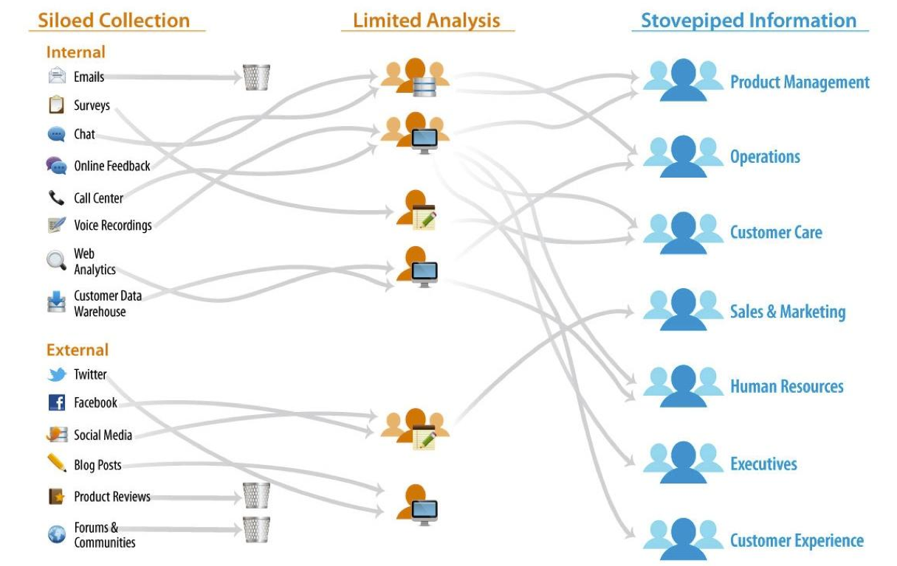
Current Solution Approaches (Quick Wins)

Slide 9
Enterprise Text Analytics (Planned)
Unified Integration
Unified Business Intelligence
Common Data Integration
Unified Actionable Information
Unstructured Data Warehouse
Common Tools and Technologies
Enterprise Data Warehouse
Notes:
Benefits: Reduce Cost, Increase footprint, Increased usage, New architectures, Semantic Web

Slide 10
Text Analytics Industry and Vendor Landscape

Slide 11
Software Licensing Models
Licensing Model | Benefits | Issues | Vendors
On-Premise Solution | Flexible, scalable enterprise solution Secured data | High initial cost Infra and support Vendor lock-in | Attensity, Clarabridge, Verint, Infosys, Oracle, SAS
Hosted (Cloud solution) | Easy to start, expand and scale Social data available at cost | High cost for enterprise solution Limited Integration Data security? | Radian 6, Attensity, ClaraBridge
Mixed Hosted and On-Premise solution | Power users on cloud and reporting on-premise | Some infra and support Some initial cost Adaptation cost | Attensity
SDK Approach | Ground-up, flexible solution Scalable and flexible | Cost to learn and architect solution | Laxalytics, Clarabridge, Attensity SDK (future)
Open-Source | Free, flexible and adaptable | High cost to learn and architect an enterprise solution | openNLP, UIMA, GATE, NLTK, Data Miner, R

Slide 12
Vendors Landscape
Today
Based on demo and limited POC work
 | Attensity | ClaraBridge | Lexalytics | Verint | Infosys | Oracle Endeca | SAS Text Miner
Sentiment Analysis | 5 | 4 | 4 | 4 | 4 | 4 | 2
Completeness of Text Analytics | 4 | 3 | 5 | 3 | 2 | 4 | 3
User Experience | 4 | 3 | 2 | 3 | 3 | 4 | 2
Total Cost of Ownership | 3 | 4 | 2 | 2 | 3 | 3 | 2
Integration | 2 | 4 | 2 | 2 | 2 | 3 | 2

Slide 13

Text Analytics Architecture Components
End User Applications
Analyst Workbench
Text Analytics Engine
Unstructured Data Store
Unstructured Data Capture and Integration
Unstructured Data

Slide 14
Decision Point?
Enterprise Capabilities
Continue with Quick Wins

Slide 15
Current State and Next Steps
Current Activities:
Next Steps:
Completed Data Innovation POC for Email forums and Glass-door text data
Collaborated with Marketing, Services and Other Business Operations teams
Vendor Engagement and Feature Analysis
Industry Research
Identify a high-value business use-case and ROI
Vendor selection process
Scale and Architect as an Enterprise-wide capability for Text Analytics

Slide 16
Cisco Maestro Platform Customer, Media, Internal Forums Listening

Slide 17
Cisco Maestro Visible Technologies / Cymfony Strategic Marketing and Communication
5-6 Years development work
Created by Cymfony consulting partner, now acquired by Visible Technologies
Sentiment Analysis for 150 companies, 500 categories, 100s of Dashboards
Unlimited Access and Lot of Content
24x7 access to all Cisco
Data regularly updated from News-media and social sites as well as internal forums, cisco blogs and event chats.
Consistent yet customizable categories / entities def.
Enterprise categorization, metrics
Customizable personalized views for self-service

Slide 18
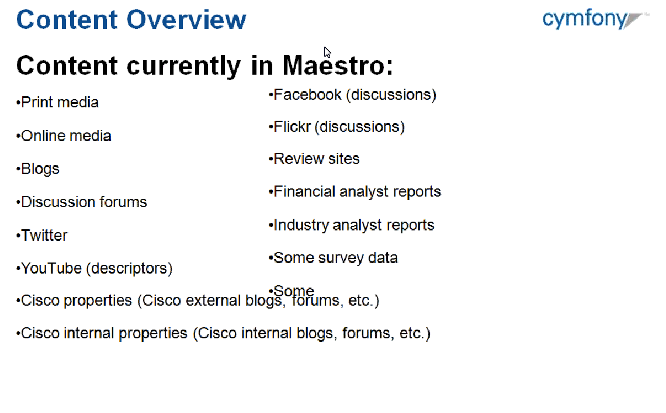
Content Overview
New Content can be added
Ingested by the system every 15 minutes to max. 1 day

Slide 19
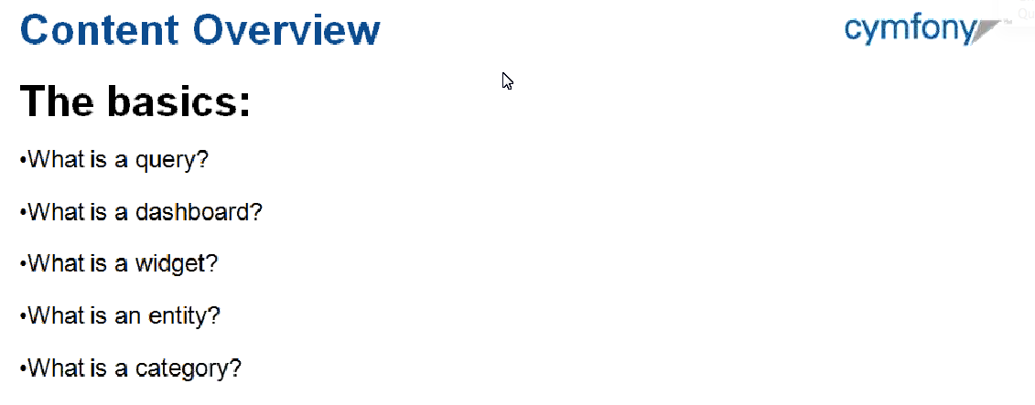
System Features
Robust Natural Language Processing Engine
Cisco Content Quality Team enhancements
Dashboards Content
Self – Service Features
Copy/Paste Dashboards and personalize
Customizable widgets sharable across platforms
Download Widget Visual or underlying Data

Slide 20
System Operations and Data Management
System built for Listening not Publishing
New Content reflected every 15 min or max 1 day
Categorization model built to meet business requirements

Slide 21
Technology

Slide 22
Solution Approaches
Text Analytics Solution Approaches
Natural language Processing or Lexical Analysis
Statistical Analysis / Machine Learning
Analytics and Data Visualization

Slide 23
Text Analytics Process
Information Identification
Parsing Text / Natural Language Processing
Feature Extraction / Linguistic Analysis
Semantic Analysis
Data Analysis or Data Visualization
Information Capture

Slide 24
Natural language Processing
Part of Speech(POS) Tagging Nouns, Adjectives, Verbs…
Subjectivity Analysis, identify Sentiment bearing phrases
Lexical Chaining
Identifying Triples / Entities Detections
Categorization / Theme/ Topic Detection
Summarization

Slide 25
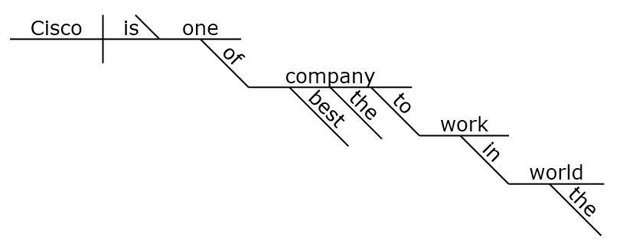
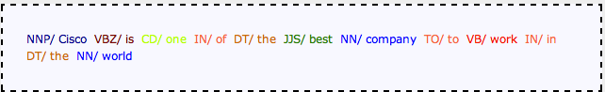
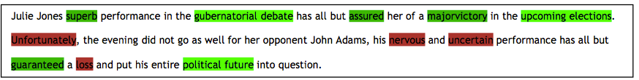
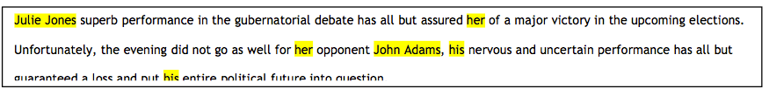
Natural language Processing Techniques
Sentence Structure
Part of Speech Tagging
Sentiment Phrase Tagging
Entity Tagging

Slide 26
Natural language Processing Techniques
Triples: (Entity, Aspect, Sentiment)
Aspect
Aspect
Aspect
Entity
Entity
Aspect
Entity
Opinion
Opinion
Entity
Opinion
Aspect
Aspect
Opinion
Entity
Entity
Opinion
Opinion
^{Example \}
I bought an iPhone a few days ago. It is such a nice phone. The touch screen is really cool. The voice quality is clear too. It is much better than my old Blackberry, which was a terrible phone and so difficult to type with its tiny keys.

Slide 27
Statistical / Data Mining Techniques
Bag of Words
Documents, blogs, emails
Docid | Word1 | Word2 | Word3 | Word5 | Label
Doc1 | 5 | 3 | 4 | 2 | 1
Doc2 | 2 | 4 | 1 | 2 | 0
Doc3 | 1 | 4 | 0 | 1 | 0
Doc4 | 4 | 6 | 0 | 0 | 1
Doc5 | 0 | 0 | 6 | 1 | 1
Standardized Documents Sets, General XML Format
Standardized Documents Sets, General XML Format
Standardized Documents Generally XML Format
Extraction
Parse, Analyze, Summarize
Voice, Video, Social
Dictionaries, Features, Stemming, Noise word removal
Text Mining, Data Mining, Presentation
Bag of words Analysis
TF-IDF = tf(t,d) * log(Total # of documents/# of docs containing t)
(Term Frequency Inverse Document Frequency)
Bayesian Probabilistic Classification
Document Classification / Prediction
Information Retrieval
Clustering and Organizing
Information Extraction
Sentiment/Lexical Analysis

Slide 28
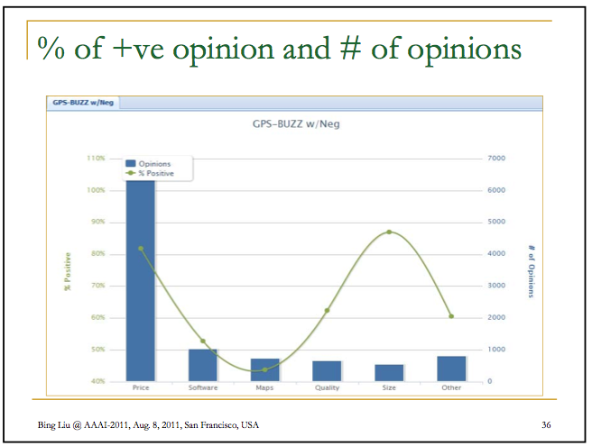
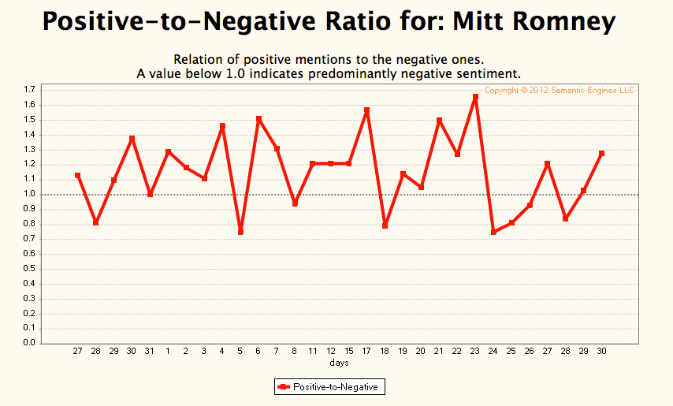
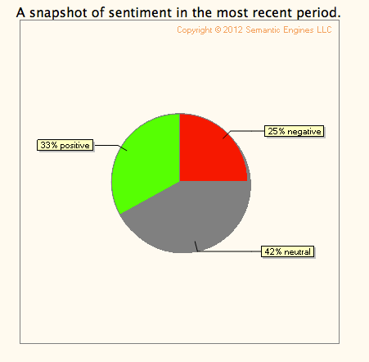
Advanced Visualization
Positive-to-Negative Ratio Analysis
Tag Cloud

Slide 29
Summary and Key Takeaways
Text and Sentiment Analysis provides additional insights into Customer Experience Intelligence
Natural Language Processing , Statistical/ Data Mining and Advanced Visualization are some solution approaches for Text Analytics
Currently multiple vendor solutions are in use in Cisco. There is a need build a common scalable enterprise platform for Text Analytics

Slide 30
Text Analytics Use Case Examples

Slide 31
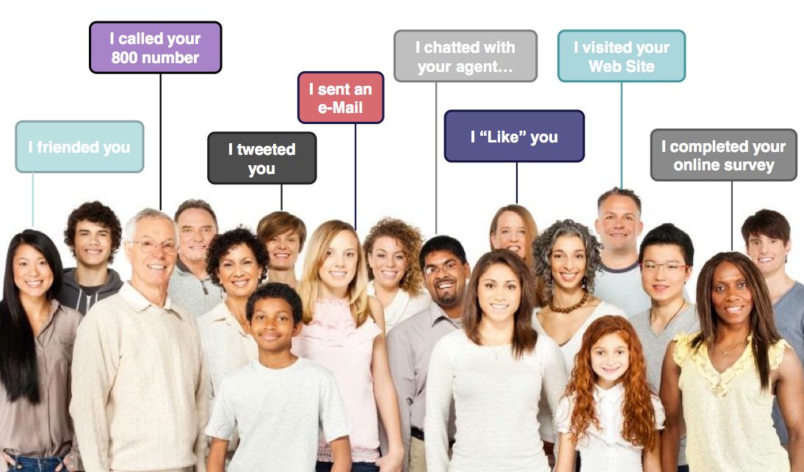
Business Use Cases
Sentiment Analysis - Listening Platforms
Voice of Customers
Voice of Employees
Listening to Social Media chatter

Slide 32

IT Services Operations
IT Services Operations Manager
Understand common problems
Read text to get sentiments
Remedy
Remedy Database
Dashboards
Data Warehouse
Sentiments/Topics
Business Benefits
Responsiveness
Improved Customer Sat.
Cost Saving
Proactive Service
Reduced # of tickets
Unstructured Data
Incidents Text
Emails,
Social ,
Forums
Facts and Opinions based BI
Solutions
Use Text Mining to automatically find common problem sets (Topics)
Use sentiment analysis to better understand satisfaction levels
Notes:
Facts and Subjective analysis, opinion mining should go together

Slide 33

Voice of Employees
Data Analysis with Structured and Unstructured Data
HR Analyst
Surveys
HR Database
Analysis / Research
Employee Sentiments / Topics Discussed
Dashboards
Real and
Complete Analysis
Additional Data Channels
Emails,
Social ,
Forums
..would like to improve employees engagement
Advanced Tools
Solutions
Listening into employees channels and understanding Sentiments provide better insights
Understanding “topics” discussed and chatter can get better insights and trending

Slide 34
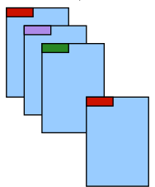


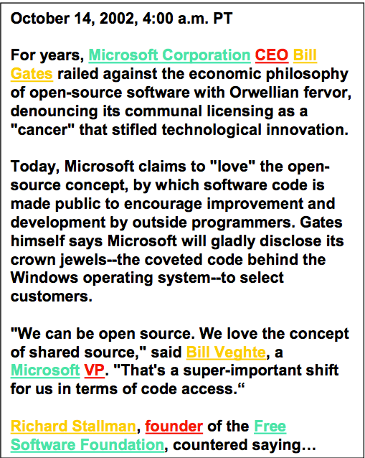
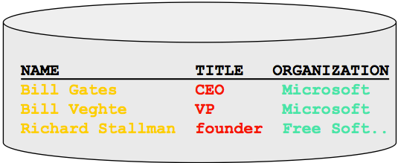
Applications Other than Listening Platforms
Automatic Clustering
Market Research, Brand management, Service management
Large # of Topics
Automatic Clustering
Documents Classification
Content Management, Market research
Unlabeled
Labeled
Entity Extraction
Key Data Extraction, Data Mining
Notes:
Market Research: Understanding your competitive place in the market can inform new product launches tune the messaging.
Service Improvements, Better Advertising
Extract important data from documents or identify major themes

